Slide 1
DATA WAREHOUSE IMPLEMENTATION

Slide 2
DATA WAREHOUSE IMPLEMENTATION
Data warehouses contain huge volumes of data.
OLAP servers demand that decision support queries be answered in the order of seconds.
Therefore, it is crucial for data warehouse systems to support highly efficient cube computation techniques, access methods, and query processing techniques.

Slide 3
EFFICIENT DATA CUBE COMPUTATION
One approach to cube computation extends SQL so as to include a compute cube operator.
The compute cube operator computes aggregates over all subsets of the dimensions specified in the operation.
This can require excessive storage space, especially for large numbers of dimensions.

Slide 4

EXAMPLE

Slide 5
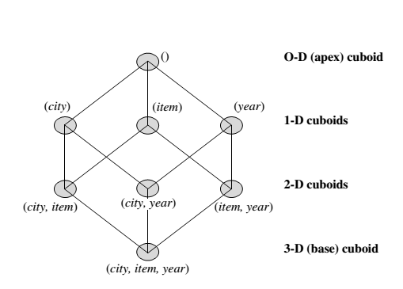
EXAMPLE
If we start at the apex cuboid and explore downward in the lattice, this is equivalent to drilling down within the data cube. If we start at the base cuboid and explore upward,
this is akin to rolling up.

Slide 6
An SQL query containing no group-by (e.g., “compute the sum of total sales”) is a zero dimensional operation.
An SQL query containing one group-by (e.g., “compute the sum of sales, group-by city ”) is a one-dimensional operation.
A cube operator on n dimensions is equivalent to a collection of group-by statements, one for each subset of the n dimensions.

Slide 7
Similar to the SQL syntax, the data cube can be defined as:
define cube sales_cube [city, item, year]: sum(sales_in_dollars)
A statement such as
compute cube sales_cube
would explicitly instruct the system to compute the sales aggregate cuboids for all eight subsets of the set {city, item, year }, including the empty subset.

Slide 8
Transform it into a SQL-like language (with a new operator cube by, introduced by Gray et al.’96)
    SELECT item, city, year, SUM (amount)
    FROM SALES
    CUBE BY item, city, year

Slide 9

“HOW MANY CUBOIDS ARE THERE IN AN N-DIMENSIONAL DATA CUBE ???”

Slide 10

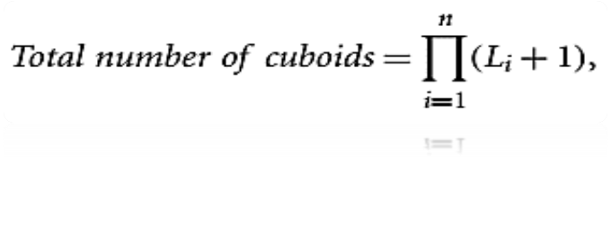
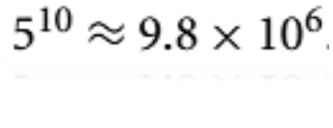
“HOW MANY CUBOIDS ARE THERE IN AN N-DIMENSIONAL DATA CUBE ???”

Slide 11
By now, you probably realize that it is unrealistic to pre-compute and materialize all of the cuboids that can possibly be generated for a data cube.
If there are many cuboids, and these cuboids are large in size.
A more reasonable option is partial materialization; that is, to materialize only some of the possible cuboids that can be generated.

Slide 12
PARTIAL MATERIALIZATION:
SELECTED COMPUTATION OF CUBOIDS
There are three choices for data cube materialization given a base cuboid:
No materialization: Do not pre-compute any of the “non-base” cuboids. This leads to computing expensive multidimensional aggregates on-the-fly, which can be extremely slow.
Full materialization: Pre-compute all of the cuboids. It is referred to as the full cube. It requires huge amounts of memory space in order to store all of the pre-computed cuboids.

Slide 13
PARTIAL MATERIALIZATION:
SELECTED COMPUTATION OF CUBOIDS
Partial materialization: We may compute a subset of the cube, which contains only those cells that satisfy some user-specified criterion. It is also referred to as sub-cube.

Slide 14
INDEXING OLAP DATA:
BITMAP INDEX AND JOIN INDEX
To facilitate efficient data accessing, most data warehouse systems support index structures and materialized views (using cuboids).
Bitmap indexes have traditionally been considered to work well for data such as gender, which has a small number of distinct values, for example male and female, but many occurrences of those values.

Slide 15
BITMAP INDEX
The bitmap indexing method is popular in OLAP because it allows quick searching in data cubes.
If a given attribute’s domain consists of n values, then n bits are needed for each entry in the bitmap index (i.e., there are n bit vectors).
If the attribute has the value v for a given row in the data table, then the bit representing that value is set to 1 in the corresponding row of the bitmap index. All other bits for that row are set to 0.

Slide 16
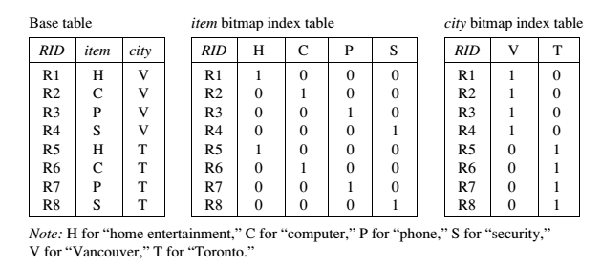
BITMAP INDEX

Slide 17
BITMAP INDEX FACTS
Bitmap indexing is advantageous compared to hash and tree indices.
It is especially useful for low-cardinality domains.
Bitmap indexing leads to significant reductions in space and input/output (I/O) since a string of characters can be represented by a single bit.
For higher-cardinality domains, the method can be adapted using compression techniques.

Slide 18
JOIN INDEXING
Traditional indexing maps the value in a given column to a list of rows having that value.
Join indexing registers the joinable rows of two relations from a relational database.
Join indexing is especially useful for maintaining the relationship between a foreign key and its matching primary keys, from the joinable relation.
Join index: JI(R-id, S-id) where R (R-id, …)  S (S-id, …)

Slide 19

JOIN INDEXING
In data warehouses, join index relates the values of the dimensions of a star schema to rows in the fact table.
E.g. fact table: Sales and two dimensions city and product.
Join indices can span multiple dimensions.

Slide 20
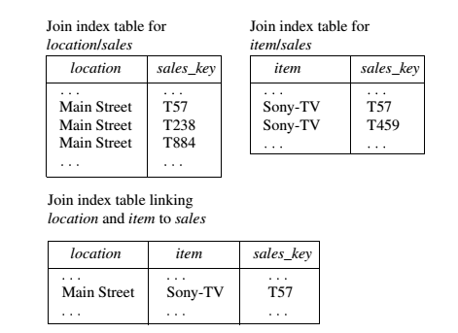
EXAMPLE

Slide 21
EFFICIENT PROCESSING OF OLAP QUERIES
The purpose of materializing cuboids and constructing OLAP index structures is to speed up query processing in data cubes. Given materialized views, query processing should proceed as follows:
Determine which operations should be performed on the available cuboids.
Determine to which materialized cuboid(s) the relevant operatiozns should be applied.

Slide 22
EXAMPLE
Suppose that we define a data cube for AllElectronics of the form “sales cube [time, item, location]: sum(sales in dollars).”
The dimension hierarchies used are
“day < month < quarter < year ” for time ;
“item name < brand < type ” for item;
“street < city < province or state < country ” for location.

Slide 23
Suppose that the query to be processed is on {brand, province_or_ state}, with the selection constant “year = 2010.” Also, suppose that there are four materialized cuboids available, as follows:
cuboid 1: {year, item_name, city}
cuboid 2: {year, brand, country }
cuboid 3: {year, brand, province_or_state}
cuboid 4: {item_name, province_or_state }, where year = 2010
“Which of these four cuboids should be selected to process the query?”

Slide 24
RESULT
Finer-granularity data cannot be generated from coarser-granularity data.
Therefore, cuboid 2 cannot be used because country is a more general concept than province or state.
Cuboids 1, 3, and 4 can be used to process the query

Slide 25
“How would the costs of each cuboid compare if used to process the query?”

